Slide 1
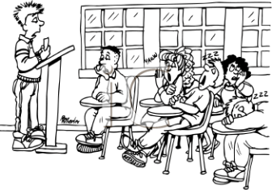
Nobody Cares What You Think!
UCTE Conference 13 November 2015
Joe Anson
Spanish Fork Jr. High
CUWP Teacher Consultant
joeaveragewriter@gmail.com

Slide 2
SECRET:
Nobody cares about your opinion.

Slide 3
Your job is to make people care.
How?
Authority/experience?
Trust/personal connections?
Evidence?
You have to prove that your opinion is worth listening to!

Slide 4
Students Struggle
Most common comments:
Add more concrete details
Add more specific evidence
Why?
Rushing
“Instant gratification”
Lack of confidence; don’t trust themselves as learners/writers

Slide 5
Get them to ask
Why?
Like an annoying two-year-old (Question Time)
Opinion writing:
Start in elementary school but applicable to all ages
Might need some prompts
Start with personal connections
Graphic organizers can help with organization and realization of lack of details

Slide 8
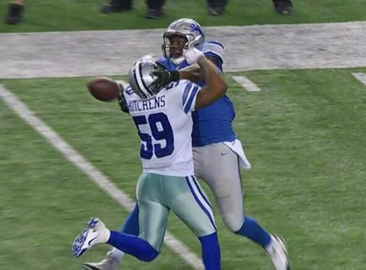
When finished, get them to evaluate evidence:
Logical/rational thinking: Do my thoughts hold water?
Bandwagon sports fans
“P.I.!”

Slide 9
Thinking “Rationale-ly”
It’s all about supporting your ideas.
Argument and informational writing
Big push with core
Most do good job in teaching to find evidence with given material
Students can accomplish this when pointed to sources
Returning to the text: literary writing—explication, analyses

Slide 10
Evidence
Quantifiable: you can point to it
Other kinds of evidence?
Interpretation
Narrative details: having enough support to keep the reader engaged or construct concrete images
Qualitative evidence: narrative with interpretation
Statistics vs. Narrative
SAGE vs. SLO?
Research

Slide 11
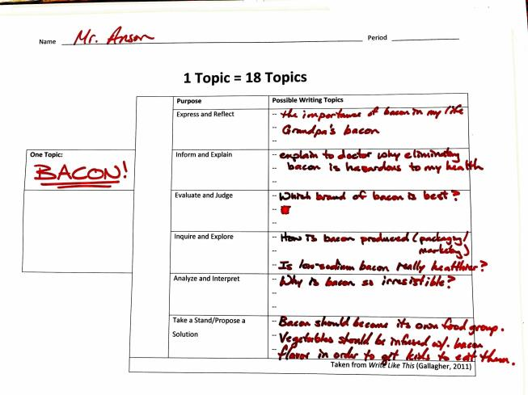
How to Teach?
Brainstorming what kind of evidence would I need?

Slide 12
Boring!
Nobody cares about your evidence if it is boring.
Core Drawback: sticking strictly in the “four corners of the text” (Gallagher, 2013).
Students and members of the human race need to make connections not just between texts, but with the world and with own lives
If the writer doesn’t care…

Slide 13
“Nobody Cares
…how much you know until they know how much you care.”
Evidence of caring comes through personal relationships
In writing it comes through in the concrete details, specific examples, voice, mastery of language
Academic writing does not have to be boring!

Slide 14
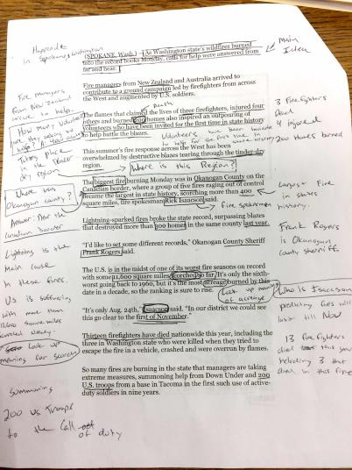
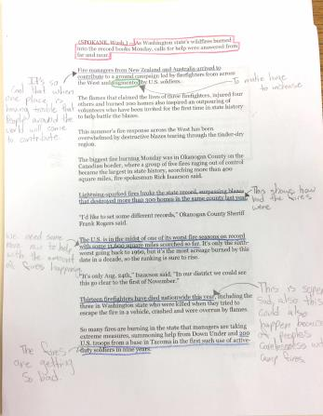
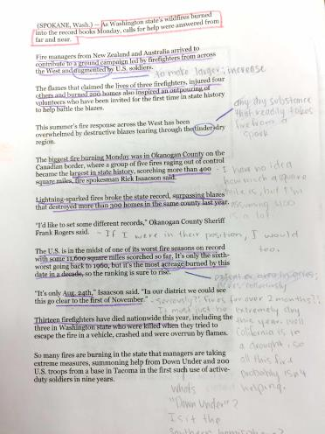
Article of the Week

Slide 15
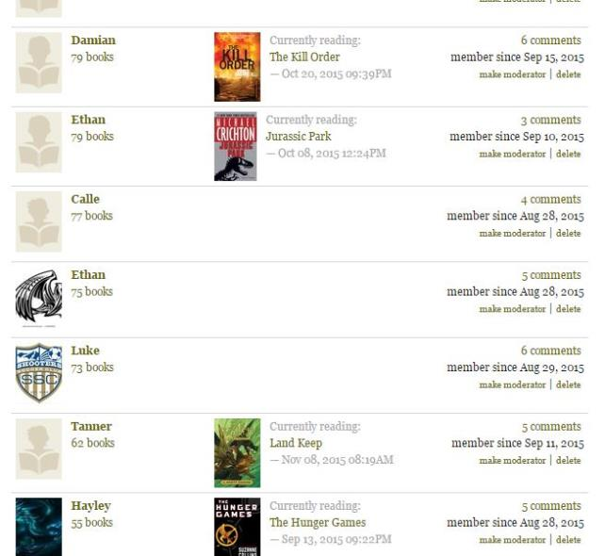
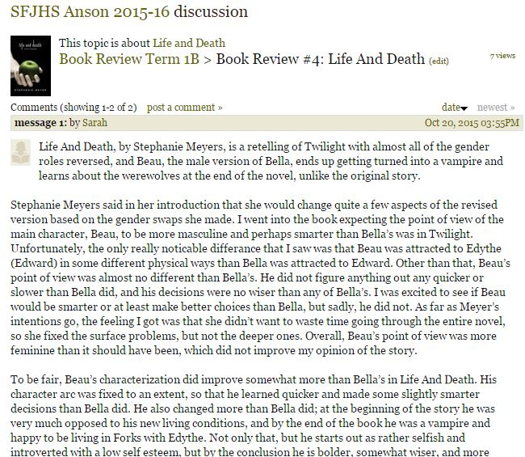
Book Reviews

Slide 16
Warning!
Not license to ignore purpose, tone, audience, etc.
Time and a place for formal writing
APA accepts writing in first person in research, so why can’t high school students do it?
Don’t overdo it, though; it can bog down many students.
Discuss what types of evidence would be valid to support each assignment/genre.
Model!

Slide 17
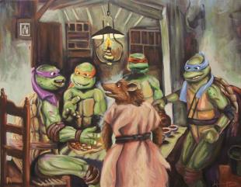
More Examples:
Art
Commercials/Print ads (effective?)
Websites (valid?)
Argument of judgment—establishing criteria
Good ol’ persuasive writing
Character sketches (real or police reports)

Slide 18
Rationale Application:
Grades
Other school subjects
Teacher evaluations
What to get for lunch
Comparative shopping
Social media posts
Dating game
Can you back up your opinions/claims with enough evidence to make people care?

Slide 19
So What?
If students can start to answer this question for themselves when expressing their opinions, making decisions, and writing for any purpose, they, themselves, begin to care. And when they become passionate enough to care about their own attitudes and opinions, they will strive to make others care as well.

Slide 20
Make People Care!
joeaveragewriter@gmail.com
joeaveragewriter.blogspot.com

